Slide 1

Bio Medical Text Classification Using ML Models
Report for MIST 6170 Advance Machine Learning
Spring 2025
By:
Abhishek Kumar Singh
Nithyashree Bandihalli Rangaswamy
Sanjay Sandhosh

Slide 2

Business Problem
Challenge
Goal
Rapid growth of biomedical literature
Automated cancer research classification
Benefits
Accelerate workflows, save time and cost

Slide 3




Machine Learning Techniques
TF-IDF + Classical Models
Naive Bayes, Logistic Regression, SVM
Ensemble Methods
Random Forest, XGBoost
Deep Learning
LSTM and CNN models

Slide 4

Dataset Overview
6,000
3
Research Abstracts
Cancer Types
Balanced across cancer types
Colon, Lung, Thyroid
0
Missing Values
Complete dataset

Slide 5

Data Pre-processing Steps
Data Splitting
Text Processing
60% training, 20% validation, 20% testing
Data Cleaning
Removed stop words using NLTK
Column renaming, null value checks

Slide 6
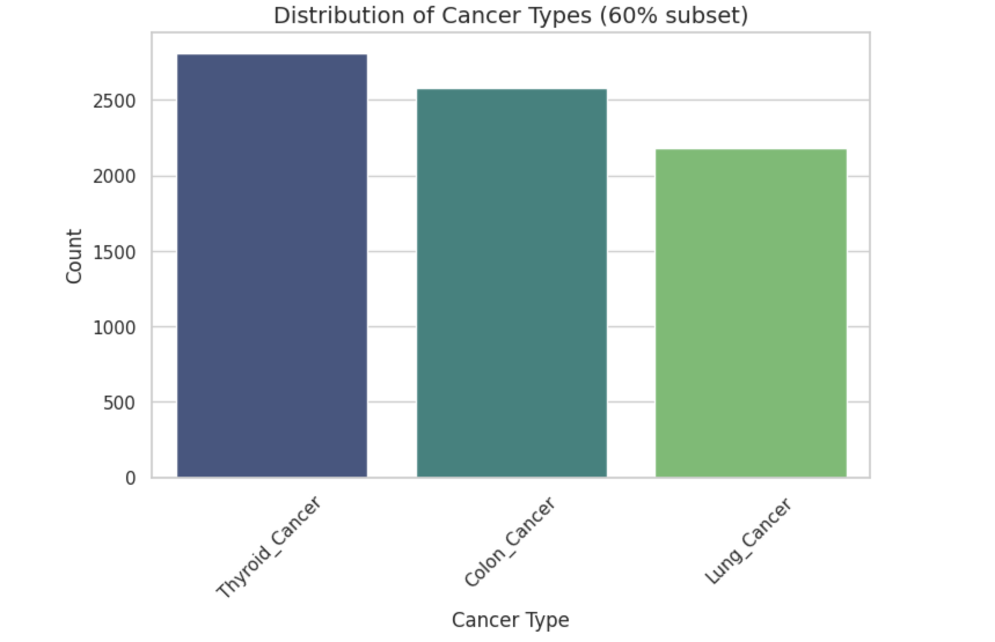
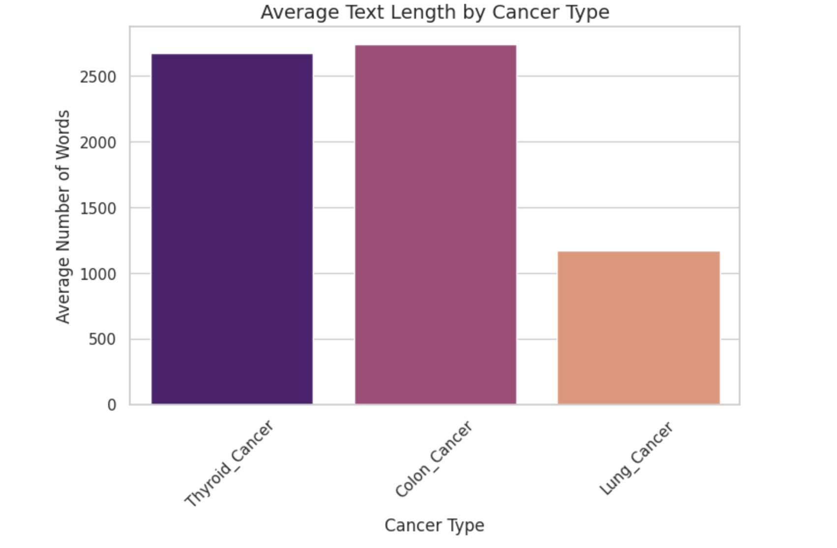
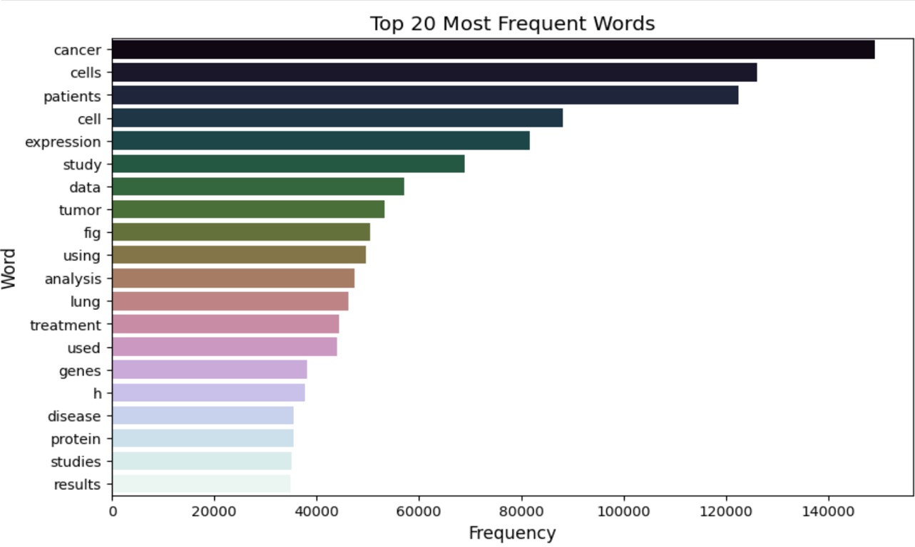
Exploratory Analysis
Distribution analysis showed balanced classes with distinct terminology patterns

Slide 7
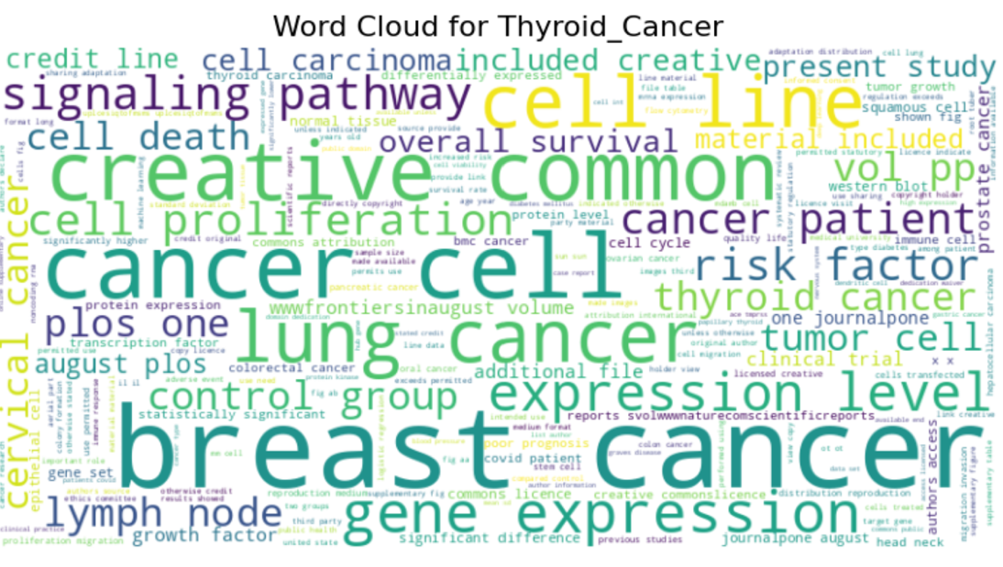



Slide 8
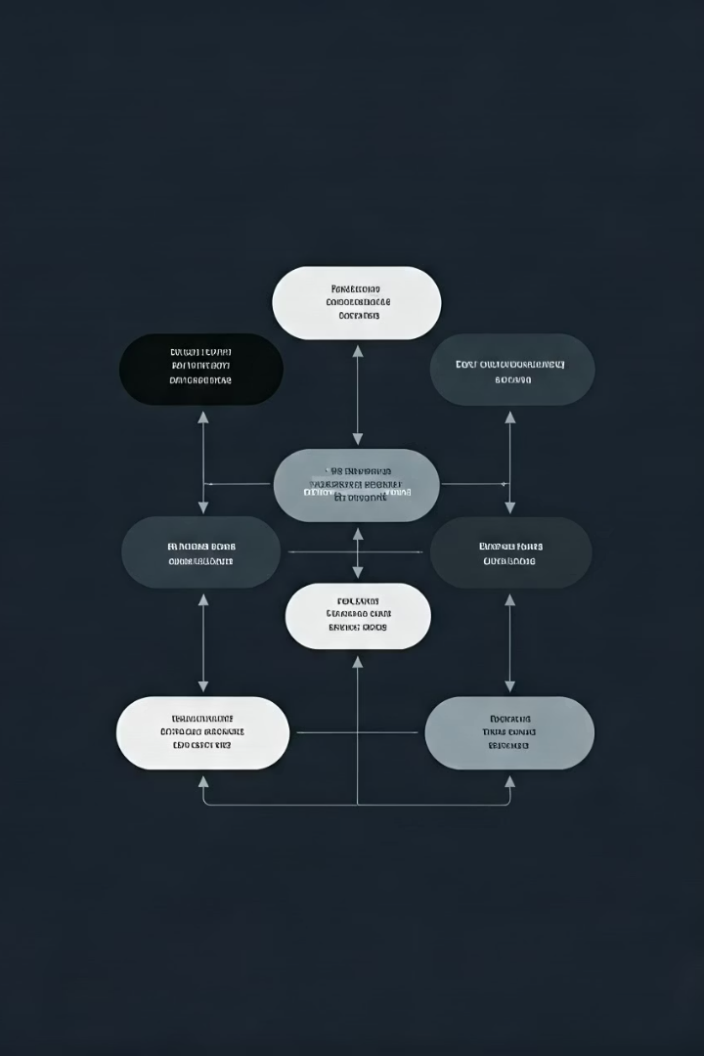




Machine Learning Process
Data Cleaning
Lowercasing, removing punctuation, stop words
Feature Engineering
CountVectorizer and TF-IDF weighting
Data Splitting
Stratified three-way split
Model Training
Classical, ensemble, and deep learning

Slide 9
Model’s Performance
Model | Validation Accuracy | Note
Multinomial Naive Bayes | 91% | Strong baseline
Logistic Regression | 93% | Highest among linear classifiers
Support Vector Classifier (SVC) | 92% | Nearly identical to Logistic Regression
Random Forest | 100% | Likely overfitting—unpruned trees
XGBoost | 100% | Likely overfitting
LSTM | 85% | 1 LSTM layer
CNN | 97.29%

Slide 10




Practical Implications
Reduced Workload
System Integration
Streamlined literature review process
Embed in libraries and clinical platforms
Future Extensions
Add more cancer types, real-time processing

Slide 11
Challenges & Conclusion
Challenges
Conclusion
Inflated accuracy on clean data
CNN achieved highest reliable accuracy
Heavy resource requirements
97.16% test accuracy
Reproducibility issues
Ensemble models likely overfitting

Slide 12
THANK YOU

